Slide 1





Email Spam or Ham Classifier

Slide 2
WHAT DOES IT DO?

Slide 3
The "Email Spam or Ham Classifier" project is motivated by the urgent need to enhance email security, improve efficiency in email management, and provide educational and practical value in data science and Information Security.

Slide 4

Never trust any unknown, suspicious or untrustworthy source/links.

Slide 5



1. Project Kit
Modules & Frameworks used

Slide 6
1. Languages and Frameworks:
Python (Flask, Scikit-learn, Pandas), HTML/CSS/JavaScript (Bootstrap).
2. Environment:
Jupyter Notebooks, Geany, VSCode.
3. Data:
“emails.csv” (email dataset).

Slide 7








Implementation, and Testing

Slide 8
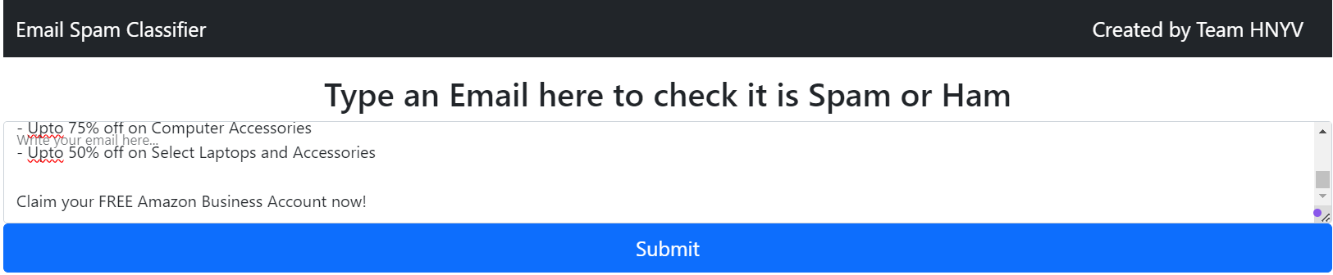
Spam Mail Test Case

Slide 9
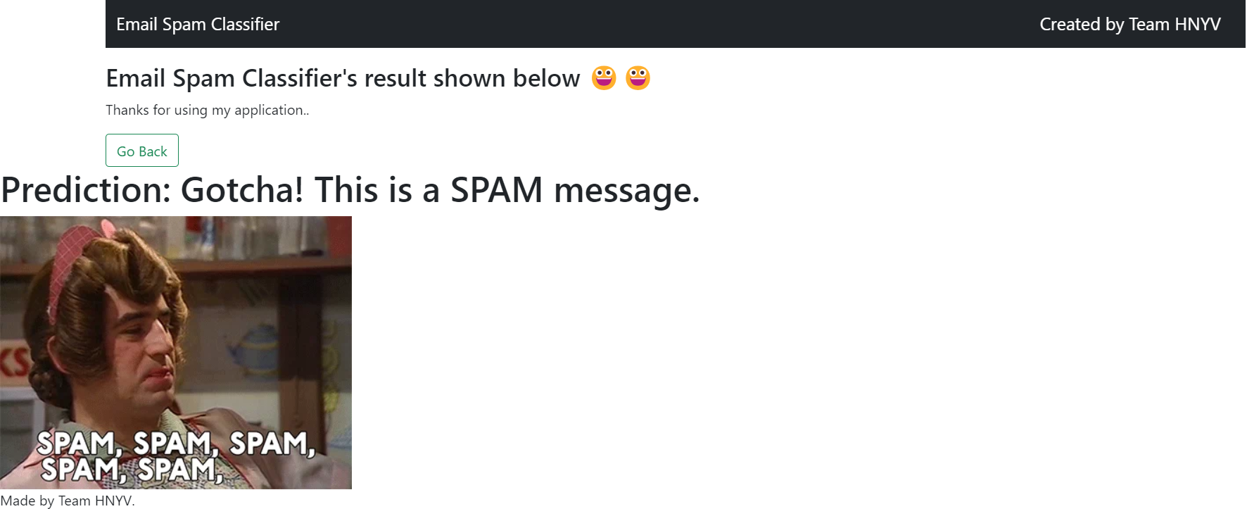
Result

Slide 10
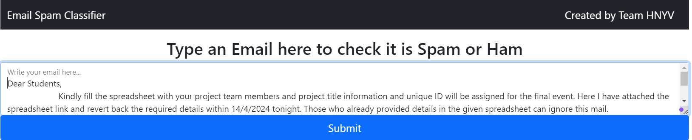
Ham Mail Test Case

Slide 11
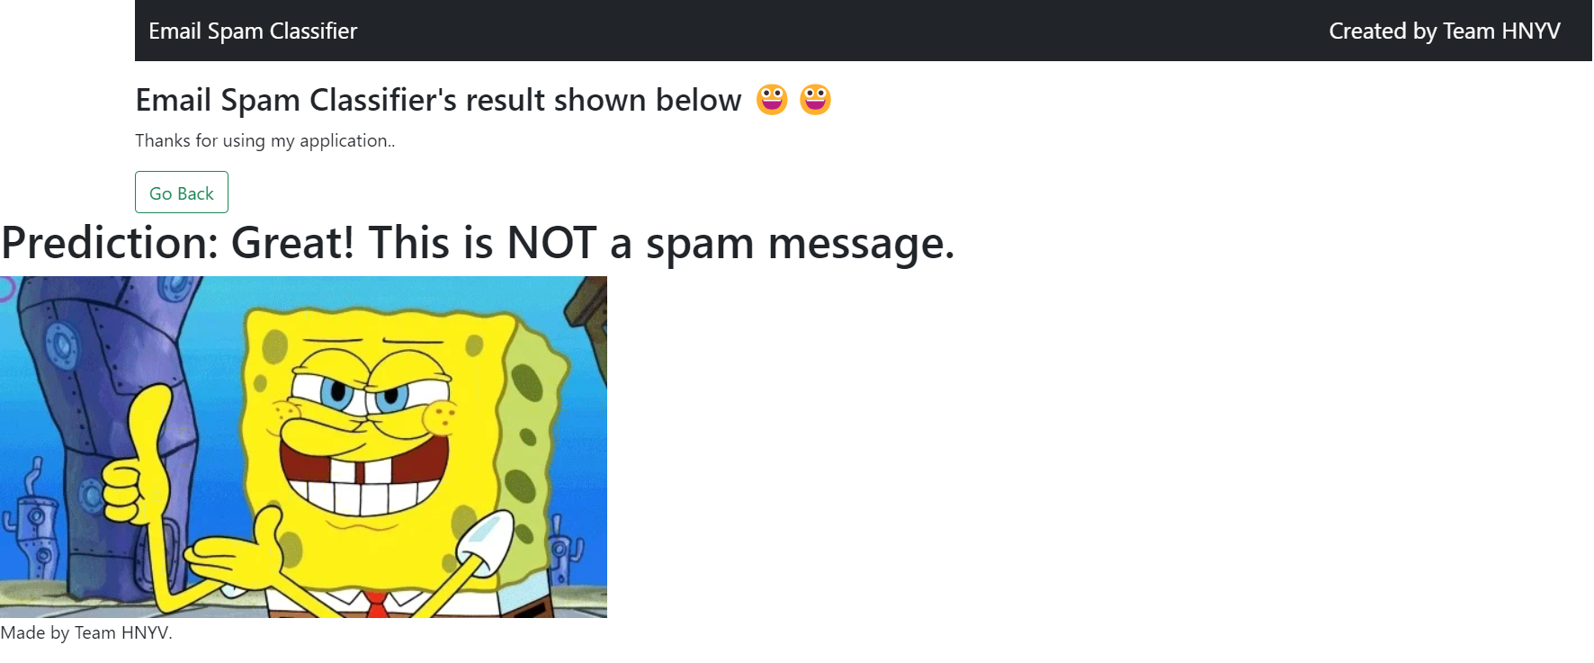
Result

Slide 12
Conclusion

Slide 13
The machine learning-based network/email security project successfully detected and classified threats, reduced false positives, demonstrated scalability, contributing significantly to security measures.
It helps an user to identify some common spam emails and ham mails that are present in our dataset.

Slide 14

Thanks!
Any questions?

Slide 15
Team Presentation
M.HANUMANTHARAO 21BIT0487
S.NAVANEETH 21BIT0464
K.VISHNU KUMAR 21BIT0166
M.YESES CHANDRA REDDY 21BIT0585
SAI KRISHNA NP 21BIT0419
Guided by faculty - Dr. Mohana Priya P
Acknowledgements:
Thanks to VIT & SCORE

